Slide 1
Flight Prices Prediction Project
Team OU
Bader Ayman Alhindi
Abd Alrahman Wael Ayyash
Kareem Omar Yousef

Slide 2

Our Methodology
Data Cleaning and Preprocessing
Machine Learning Models
handling missing values,
transforming techniques and normalization
random forest regressor model, train and test, the best score,
r squared and cross validation
Data Collection
Analysis Techniques
”Flight Price Prediction” uploaded by ”Muhammad Bin Imran” on a website under the name of
describe function, value counts function, getting the means of some data and visualizing some results

Slide 3

Results / Insights
Feature importance
R-squared
Cross Validation

Slide 4
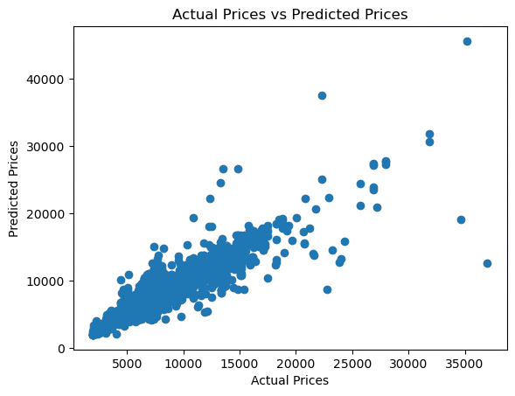
Actual Price – Predicted Price

Slide 5
Thanks
Do you have any questions?

